Slide 1

Blockchain Technologies for an Advanced and Cyber-Resilient Automotive Industry
GROUP : DEMON SLAYER
PRESENTED BY :
SHUBHAM PATEL (029414292)
ROHAN BORAD (030753448)

Slide 2

Introduction:
The emergence of blockchain technology and its impact on various industries, particularly its application in the automotive sector.
The potential of blockchain to revolutionize aspects of vehicle manufacturing, supply chain management, and customer experience.
The significance of blockchain in enhancing cybersecurity in automotive applications, crucial with the advent of connected and autonomous vehicles.

Slide 3

Objectives:
To provide a comprehensive review of how blockchain technology is being applied in the automotive industry.
To explore the challenges and potential solutions associated with implementing blockchain in this sector.
To discuss the future of the automotive industry with blockchain technology, considering advancements, upcoming projects, and long-term prospects.

Slide 4
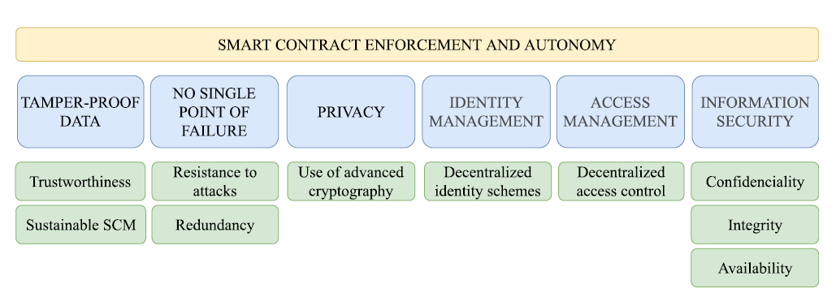
Blockchain in Automotive industry:

Slide 5

TAMPER-PROOF DATA
Consistent Data Need:
- Essential for multi-stakeholder industries.
Blockchain Timestamping:
- Immutable timestamps for each transaction.
Traditional Risks:
- Malicious backdating by central servers.
Blockchain's Defense:
- Proof-of-Work (PoW) prevents Sybil attacks.

Slide 6

NO SINGLE POINT OF FAILURE
Open-Source Security:
- Continuous monitoring by multiple contributors reduces malicious alterations.
Centralization Risks:
- Traditional databases vulnerable to system-wide failures.
Blockchain Resilience:
- Each node contains a complete blockchain copy, enhancing fault tolerance.
Cloud Vulnerabilities:
- Susceptible to DoS attacks, maintenance downtime, and data breaches.
Distributed Defense:
-Computing power spread across nodes; malicious nodes can be isolated.

Slide 7

PRIVACY
Public-Key Cryptography:
- Ensures security and privacy.
- RSA and ECDHE are the main cipher suites.
ECC vs. RSA:
- ECC: faster and more energy-efficient.
- NSA's shift due to quantum computing advancements.
User Anonymity:
- Users identified by public keys, not personal information.
Enhancing Privacy:
- Techniques like multichains, mixing protocols, and zero- knowledge proofs protect user identities.

Slide 8

IDENTITY MANAGEMENT
Definition:
- Management of attributes in identities, controlled by the identity provider.
Types of Schemes:
- Centralized: Single entity control, wide application (e.g., national IDs).
- Federated: Cross-domain access (e.g., single sign-on).
- User-Centric: User-owned and controlled (e.g., network anonymization).
Decentralized Identity:
- Emerging trend, increased security via asymmetric key rotation.
DLT in Identity Management:
- Strengths, challenges, and evaluations (uPort, ShoCard, Sovrin).

Slide 9

ACCESS MANAGEMENT
Control Mechanisms:
- Policies and tools for authorized system/application access.
Blockchain Application:
- Proposal for blockchain-based access control and permissions.

Slide 10

INFORMATION SECURITY
Confidentiality:
- Decentralized storage in blockchain enhances data privacy.
- Key management systems protect private keys.
Integrity:
- Blockchain ensures data immutability; hard forks are rare exceptions.
- Proposals for preserving data integrity in third-party information collection.
Availability:
- Data distributed among peers; susceptible to 51% attack.

Slide 11
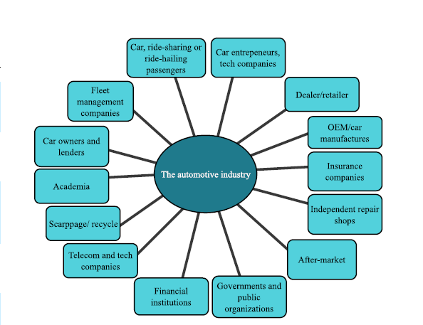
MAIN STACKHOLDERS IN AUTOMOTIVE INDUSTRY:

Slide 12
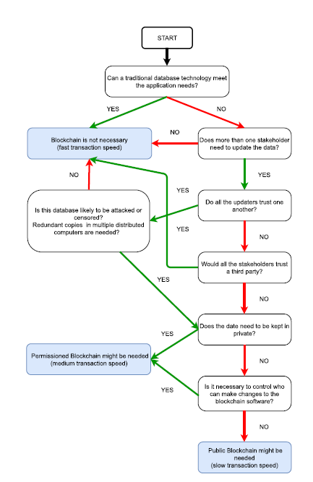
Assessing Blockchain Need: A Decision-Making Flowchart

Slide 13
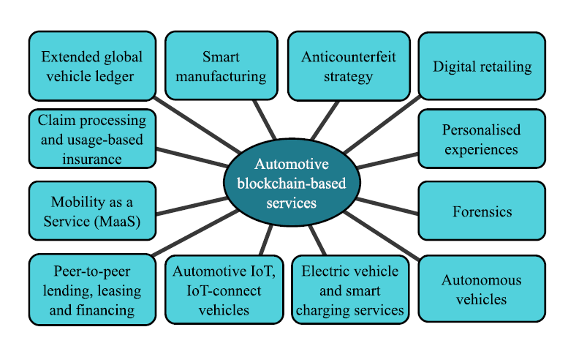
AUTOMOTIVE BLOCKCHAIN BASED SERVICES:

Slide 14
BLOCKCHAIN IMPLEMENTATION AND DEPLOYMENT STRATEGY
SWOT ANALYSIS :
Strength | Weakness
Operational Efficiency | Scalability Issues
Cyber Resiliency | Low Performance
Fast and simple transfer with no Fees | Criminal Activity, Malicious attacks
Transparency | Privacy Issues
Global Accessibility | Poor user Experience, User Unfamiliarity
Reduction in Human Errors | High energy consumption

Slide 15
Opportunity | Threats
Fraud Reduction | Technological vulnerabilities
Reduced systemic risk | Perception of Insecurity
Ease in cross border trade | Medium or long-term investment
Network effect | Unreliability
New business model enabler | Unfavorable government policies

Slide 16

CHALLENGES:
Technical Complexity:
- Focus on scalability, privacy, security, and quantum resistance.
- Need for decentralized business processes.
Interoperability:
- Critical for integrating with legacy systems.
- Adoption of international standards essential.
- Federated Identity Management for cross-enterprise authentication.

Slide 17

CONCLUSION:
blockchain technology holds transformative potential for the automotive industry, offering a secure, decentralized platform for various applications. However, careful consideration and objective evaluation are essential before widespread adoption and investment.

Slide 18

Thank you!!

